Slide 1
463.7 Information Flow
Computer Security II
CS463/ECE424
University of Illinois
Notes:
Based on slides by Carl A. Gunter and Matt Bishop.

Slide 2

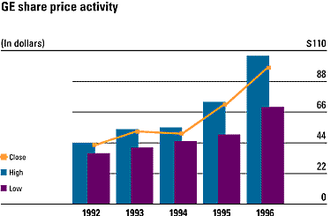

Example: Financial Planner
Downloadable financial planner:
Disk
Network
Accounting
Software
Access control insufficient
Encryption necessary, but also insufficient

Slide 3
Noninterference
Disk
Network
Accounting
Software
Private data does not interfere with
network communication
Baseline confidentiality policy

Slide 4
Example: Payment Smart Card
Smart card for financial transactions
Card contains sensitive financial information used to make a transaction
Used in the terminal of a merchant
Card is tamper-resistant, protects card secrets from both the merchant and card holder
Java cards provide limited card-based computation
Must split the computation between the card, the terminal, and network connections

Slide 5
Model of Noninterference
Represent noninterference as a relation between groups of users and commands
Users in group G do not interfere with those in group G’ if the state seen by G’ is not affected by the commands executed by members of G
[GoguenM82J
Notes:
[GoguenM82J Security Policies and Security Models, J. A. Goguen and J. Meseguer. IEEE Security and Privacy 1982.
http://seclab.uiuc.edu/docs/GoguenM82.pdf

Slide 6
State Automaton
U – Users
S – States
C – Commands
Out – Outputs
do : S × U × C → S – state transition function
out : S × U → Out – output function
s₀ – initial machine state

Slide 7
Capability System
U, S, Out – users, states, commands, and outputs as before (in a state machine)
SC – State commands
Capt – Capability tables
CC – Capability commands
out : S × Capt × U → Out
do : S × Capt × U × SC → S
cdo : Capt × U × CC → Capt – Capability selection function
s₀ ∈ S and t₀ ∈ Capt – Initial state and capability tables

Slide 8
Transition Function
C = SC ⊎ CC - Commands
csdo : S × Capt × U × C → S × Capt
  csdo(s,t,u,c) = (do(s,t,u,c),t) if c ∈ SC
  csdo(s,t,u,c) = (s,cdo(s,t,u,c)) if c ∈ CC
csdo* : S × Capt × (U × C)* → S × Capt
  csdo*(s,t,nil) = (s,t)
  csdo*(s,t,w.(u,c)) = csdo(csdo*(s,t,w),u,c)
[[w]] = csdo*(s₀,t₀,w)
[[w]]_{u} = out([[w]],u)

Slide 9
Projection
Let G ⊆ U and A ⊆ C and w ∈ (U × C)*
P_{G}(w) = subsequence of w obtained by eliminating pairs (u,c) where u ∈ G
P_{A}(w) = subsequence of w obtained by eliminating pairs (u,c) where c ∈ A
P_{G,A}(w) = subsequence of w obtained by eliminating pairs (u,c) where u ∈ G and c ∈ A

Slide 10
Noninterference
M state machine and G, G’ ⊆ U and A ⊆ C
G :| G’ iff ∀ w ∈ (U × C)*. ∀ u ∈ G’. [[w]]_{u} = [[p_{G}(w)]]_{u}
A :| G iff ∀ w ∈ (U × C)*. ∀ u ∈ G. [[w]]_{u} = [[p_{A}(w)]]_{u}
A,G :| G’ iff ∀ w ∈ (U × C)*. ∀ u ∈ G’. [[w]]_{u} = [[p_{A,G}(w)]]_{u}

Slide 11
Security Policies
Noninterference assertions have the forms
  G :| G’
  A :| G
  A,G :| G’
A security policy is a set of noninterference assertions

Slide 12
Example 1
A :| {u}
The commands in A do not interfere with the state of user u

Slide 13
Example 2 MLS
Level : U → L - assignment of security levels in L
Above(λ) = { u ∈ U | λ ⊑ Level(u)}
Below(λ) = { u ∈ U | Level(u) ⊑ λ}
M is multi-level secure with respect to L if, for all λ ⊏ λ’ in L, Above(λ’) :| Below(λ)
Levels L ⊑
Top Secret
Secret
Unclassified

Slide 14
MLS Continued
G is invisible if G :| G^{c} where G^{c} is the complement of G in U
Proposition 1: If M,L is multi-level secure, then Above(λ) is invisible for every λ ∈ L.

Slide 15
Example 4 Isolation
A group of users G is isolated if: G :| G^{c} and G^{c} :| G.
A system is completely isolated if every user in U is isolated.

Slide 16
Example 5 Channel Control
View a channel as a set of commands A
We can assert that groups of users G and G’ can only communicate through channel A with the following two noninterference assertions:
  A^{c},G :| G’
  A^{c},G’ :| G

Slide 17
Example 6 Information Flow
A₁
u₁
A
u
u’
A₂
u₂
u’,u₁,u₂ :| u
u₁,u₂ :| u’
u₁ :| u₂
u₂ :| u₁
A^{c},u :| {u’,u₁,u₂}
A₁^{c},u’ :| {u₁}
A₂^{c},u’ :| {u₂}

Slide 18
Example 7 Security Officer
Let A be the set of commands that can change the security policy
seco ∈ U is the only individual permitted to use these commands to make changes
This is expressed by the following policy: A, {seco}^{c} :| U

Slide 19


Slide 20
Entropy and Information Flow
It is possible to analyze information flows in programs with an information theory foundation
Intuition: info flows from x to y as a result of a sequence of commands c if you can deduce information about x before c from the value in y after c

Slide 21
Example 1
y := x
  If we learn y, then we know x
  Clearly information flows from x to y

Slide 22
Example 2
Suppose we are given
  r := x
  r := r - r
  y := 1 + r
Does information flow from x to y?
It does not because r = 0 after the second command.

Slide 23
Example 3
Consider this branching command:
  if x = 1 then y := 0 else y := 1;
If we find after this command that y is 0, then we know that x was 1
So information flowed from x to y

Slide 24
Implicit Flow of Information
Information flows from x to y without an explicit assignment of the form y := f(x) where f(x) an arithmetic expression with variable x
Recall the example from previous slide:
  if x = 1 then y := 0 else y := 1;
So we must look for implicit flows of information to analyze program

Slide 25
Conservative Automated Analysis of Flow
Example 2 depends on an arithmetic property of subtraction
It is impossible to take each such property into account when doing an automated analysis
  Ultimately undecidable
Hence an automated analysis will be a conservative approximation of information flows
  All flows can be found (even if trivially!)
  Some non-flows (false positives) will be found

Slide 26
Compiler-Based Mechanisms
Detect unauthorized information flows in a program during compilation
Analysis not precise, but secure
  If a flow could violate policy (but may not), it is unauthorized
  No unauthorized path along which information could flow remains undetected
Set of statements certified with respect to information flow policy if flows in set of statements do not violate that policy
[DenningD77]
Notes:
[DenningD77] Certification of Programs for Secure Information Flow, Dorothy E. Denning and Peter J. Denning. CACM 20(7), 1977.
http://seclab.uiuc.edu/docs/DenningD77.pdf

Slide 27
Example
if x = 1 then y := a else y := b;
Info flows from x and a to y, or from x and b to y
Certified only if information from the security class x of x is allowed to flow into the security class y of y and similar conditions hold for a and b relative to y.
Write: x ≤ y and a ≤ y and b ≤ y
  Note flows for both branches must be true unless compiler can determine that one branch will never be taken

Slide 28
Declarations
x: int class {A,B}
Means x is an integer variable with security class at least lub{ A, B } so lub{ A, B } ≤ x.
Basic case is two security classes, High and Low.

Slide 29
Assignment Statements
x := y + z;
Information flows from y, z to x, so this requires lub{ y, z } ≤ x
More generally:
y := f(x₁, …, x_{n})
Require lub{ x₁, …, x_{n} } ≤ y

Slide 30
Compound Statements
x := y + z; a := b * c – x;
First statement: lub{ y, z } ≤ x
Second statement: lub{ b, c, x } ≤ a
So, both must hold (i.e., be secure)
More generally:
S₁; … S_{n};
Each individual S_{i} must be secure

Slide 31
Iterative Statements
while i < n do
begin a[i] := b[i]; i := i + 1; end
Same ideas as for “if”, but must terminate
More generally:
while f(x₁, …, x_{n}) do S;
S must be secure
lub{ x₁, …, x_{n} } ≤ glb{y | y target of an assignment in S }
Loop must terminate

Slide 32
Conditional Statements
if x + y < z
then a := b
else d := b * c – x; end
The statement executed reveals information about x, y, z, so lub{ x, y, z } ≤ glb{ a, d }
More generally:
if f(x₁, …, x_{n}) then S₁ else S₂; end
S₁, S₂ must be secure
lub{ x₁, …, x_{n} } ≤ glb{y | y target of assignment in S₁, S₂ }
Notes:
The conditional also generates conditions on a,b,c,d as well as x,y,z

Slide 33
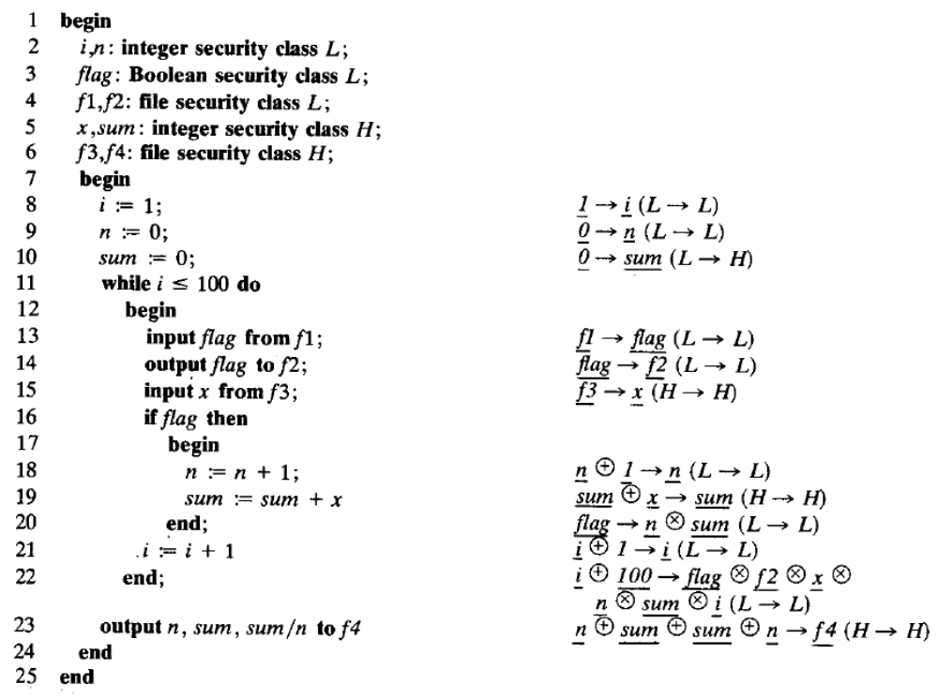

Slide 34
Need to Handle More
Procedures
Arrays
Goto Statements
Exceptions
Infinite loops
Concurrency
Etc

Slide 35
Reading
[Bishop03] Computer Security Art and Science, Matt Bishop, Addison Wesley, 2003.
  Chapter 8 up to the beginning of 8.2.1.
  Chapter 16 sections 16.1 and 16.3
[GoguenM82J Security Policies and Security Models, J. A. Goguen and J. Meseguer. IEEE Security and Privacy 1982.
[DenningD77] Certification of Programs for Secure Information Flow, Dorothy E. Denning and Peter J. Denning. CACM 20(7), 1977.

Slide 36

Discussion
Is the G/M notion of interference too strong? Consider the following two case studies.

Slide 37
Case Studies
Audit
Secret Communication
Consider the security officer in example 7. Shouldn’t the officer see audit information from the users who attempt to execute security commands?
A general tells his army that if they see a green flag they should attack from the left but if they see a red flag they should attack from the right. The general raises the green flag and the enemy forces see this. Did the signal “interfere” with the enemy?

